Slide 1
Leak detection pilot (water conservation project )
Israel Mercury (MYD)
Orly Artsi, Yochanan Mor
Sep-2014

Slide 2
Project objectives and scope
Objectives:
The present global “sweet water” situation guide us to save water in stress and in other countries by monitor and repair leaks.
During the water conservation discussions we faced a problem where there are leaks in the pipelines infrastructure almost everywhere. Normally not big leaks but can be many small lacks.
The Australian government survey found ~ 20-25% of the water “disappear” because of leaks inside the facility.
From time to time we face one time damage events in our sites due to “water flooding”,
The scope of this work is to demonstrate the necessity using leak detection system and give guidelines how \ where to use detection systems in HP facilities.
Scope:

Slide 3
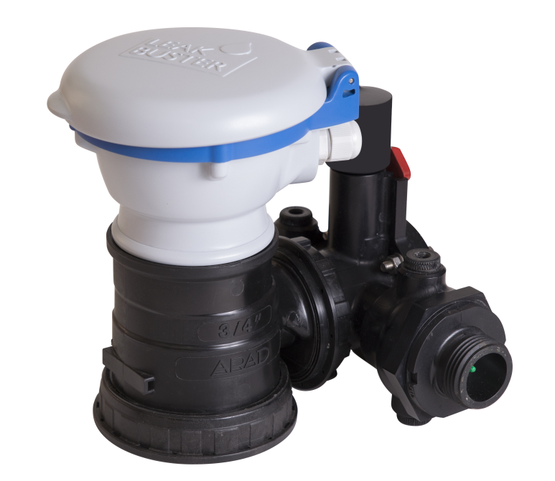
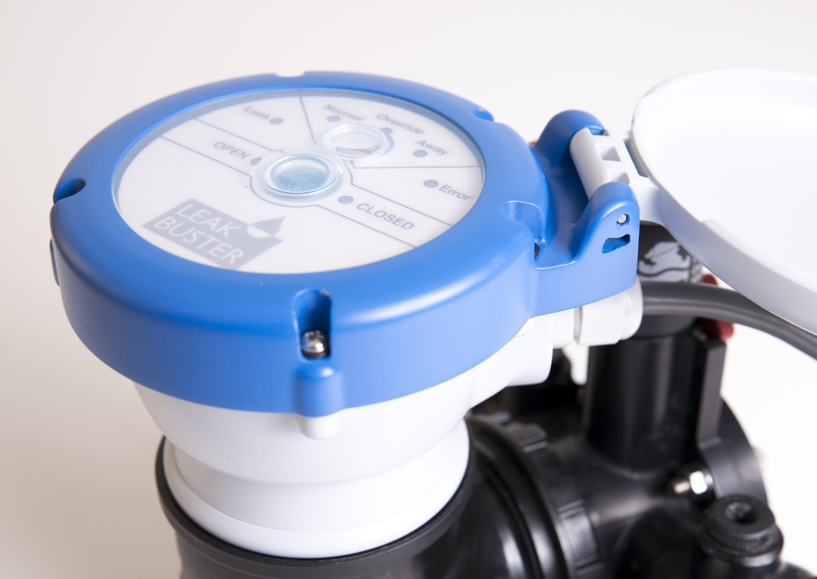
Definitions
HP joined with Israeli company name Aqua-Rimat to preform pilot in MYD 3 buildings, Yehud Israel. The pilot was running on day to day bases with the help of ISS that manage the site.
The pilot start as describe below and the data analyze for period before (purple) and after (Blue):
The device send GSM signal every 1 min to web site consolidate all data. The data can seen in the WWW and send to the user phone. Max size pip can operate with this device is 2”.
 | 1/13 | 2/13 | 3/13 | 4/13 | 5/13 | 6/13 | 7/13 | 8/13 | 9/13 | 10/13 | 11/13 | 12/13 | 1/14 | 2/14 | 3/14 | 4/14 | 5/14
M1
M2
M3
| Start pilot
| Start pilot
| Start pilot

Slide 4
Pilot information
✓
✓
✗
Meters installed in office floor, dining room, gardens but NOT all the site fully covered!
Pilot exclude parking's space
HC – on site employees (Mob, Ded, No office, N\A)
HC- NO significant change in HC detected trough the period before the pilot and until the end
Major alerts stand for leaks > 150 L
Minor alerts stand for leaks < 150 L and greater than 2 L

Slide 5
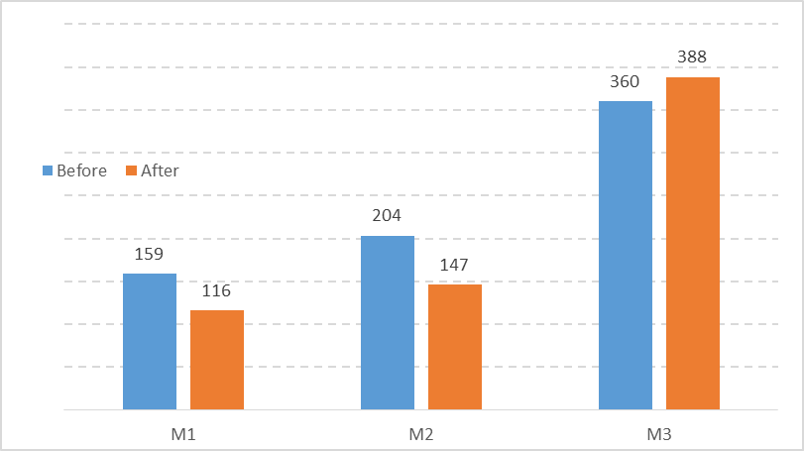
Results analysis
Significant reduction at M1 and M2, and an increase at M3 (resulting from pipes which are not covered by the Leak Buster, see comment below)
Overall Savings of 12% in water consumption in all buildings (municipal bills checkup)
before taking into account savings by water damage prevention (Statistically- there is a water damage every two- to three years).
Avg M^3 a month before\ after
✗
+8%
Several exceptional events effected the test after the sys installed:
Sprinklers drain
Change the water in dining room softener water sys
Backflow preventer
Empting building fire water reservoir
✓
-28%
✓
-27%

Slide 6
ROI map for the pilot
 |  | M1 | M2 | M3
1 | Number of units | 6 | 6 | 12
2 | Investment ($) | 4,300 | 4,300 | 8,500
3 | Yearly water consumption * ($) | 4,559 | 6,613 | 11,874
4 | Saving water consumption | -27% | -28% | 8%
5 | Yearly return ($) | 1,185 | 2,166 | No return
6 | yearly return for moderate water damage estimate ($) | 1,000 | 1,000 | 1,000
7 | ROI (years) | 2.1 | 2.1 | No return
 | * Based on 2013 overall consumption, 9.3 Nis per cubic meter
Point Nu’4: According to the Australian government survey in offices done 2009 the avg leaks estimate on the level of ~20 %
Point Nu’ 7 estimate one time event may happened from time to time generate massive expense like carpet damage.

Slide 7
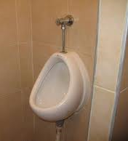
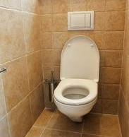
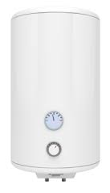

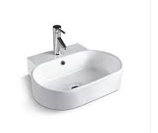
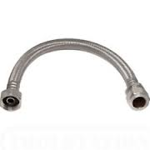
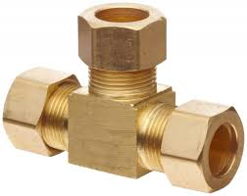
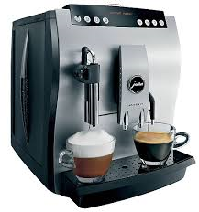
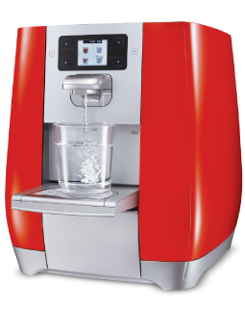
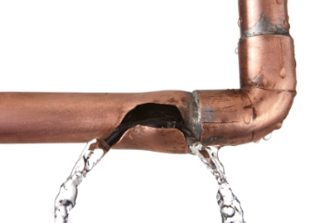
Main leaks detected through the pilot
Urinals
Running
toilets
Unsealed
toilet
Outdoor sprinkler
Forgotten open faucets
boilers
Hidden connectors
Poor infrastructure
Flexible sink pipes
Flexible toilet pipes
Coffee machines
Automated water machines

Slide 8
Update: 1-Oct-14
Recommendation for installing leak detectors devices
Water Meter Monitoring/ Leak Detection Site Selection
(whenever possible, provide separate metering for domestic water, process water, HVAC make-up water and irrigation water)
When determining where to install, prioritize the following:
Owned site or long lease sites
Sites where voluntary or mandatory water consumption reductions are required
“Top” water consuming sites
Sites located in water stressed locations
Where there is a good ROI for installing the equipment (less then 5 years)
Where leaks could damage building, equipment or have a strong impact to the business (e.g. data centers, labs and mfg areas)
Older facilities with water system in poor condition

Slide 9
Water Meter Monitoring / Leak Detection System (LDS) Requirements
Update: 19-Aug-14
GSM\ TDMA cellular connection or wired connection
Web control based system with ability for remote shutdown (if required for application)
Data extraction capabilities with XLS
SPOG compatibility (recommended)
Ability to use existing meters (desirable but ONLY in case the LDS system support it)
Reliable service for the system and device, minimum of 10 year battery life

Slide 10
End

