Slide 1
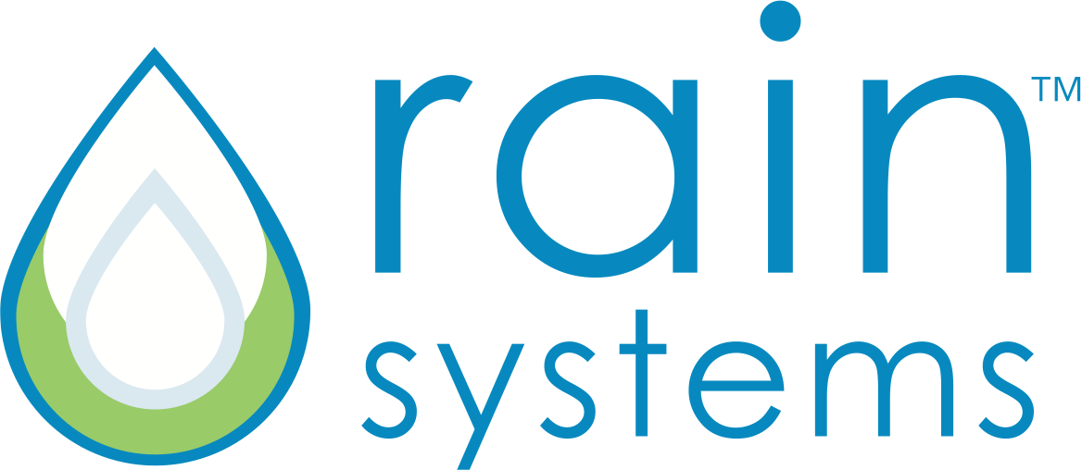
CSUN Presentation June 20, 2016
James E. Sibert, Co-Founder, CTO
Elaine R. Sibert, Co-Founder, CEO
Keith Brown, Board Member & Advisor

Slide 2
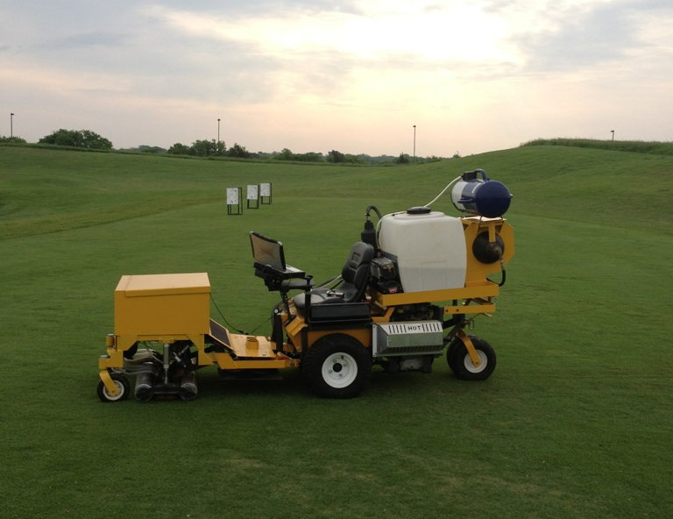
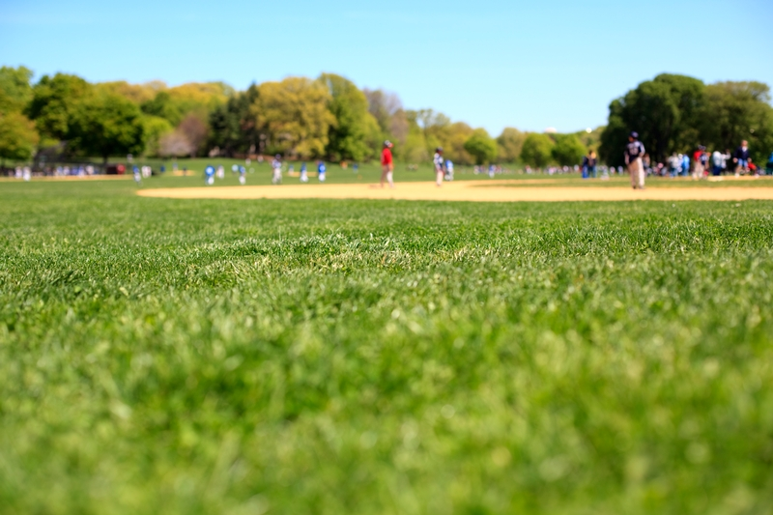
RAIN SYSTEMS EXECUTIVE SUMMARY
Rain Systems, a Los Angeles Cleantech Incubator Portfolio Company, invented the Precision Injection Machine (PIM), a patented technology that uses water pressure to implant cross-link polymer (CLP) into turf at root level without disturbing the surface of turf.
Once injected, CLP reduces irrigation requirements by 30 - 50 % and is effective for five years. The Rain Systems’ treatment leaves no visible impact on lawn aesthetics - enabling golf courses, resorts, and municipalities to keep their fairways and lawns pristine in a way that is truly sustainable.
Our computer controlled process enables us to put together a custom approach to each installation site, providing the best possible solution for the use of CLP to conserve water in turf irrigation.

Slide 3
PRECISION INJECTION MACHINE (PIM I)
Our Precision Injection Machine (PIM) uses a unique, innovative process that maintains pristine turf conditions while injecting cross-link polymer (CLP) into the ground.
Through preliminary data samples, we are able to take into account the type of turf, soil and depth of grass roots. We are then able to put together a custom approach to each installation site.
Using pinpoint water injection points, our system is the first to offer a precise and computer controlled approach. We can adjust spacing of injection points, as well as volume of CLP at a specific depth, targeting the root level.

Slide 4
CROSS-LINK POLYMERS
Cross-link polymers (CLP) were developed decades ago as an environmentally-friendly, relatively low-cost technology to help landscapers reduce irrigation demands by creating a sub-surface water storage system. These soil amendments were designed to help store water and hold nutrients within the ground until needed. CLP retains the water that is normally lost in evaporation and drainage, while providing plants with access to a source of moisture when the soil becomes dry. This helps to maintain consistent moisture levels, even between watering, and also helps plants survive temporary periods of drought.
When dry CLP are granular
Once hydrated, they expand into hydrogel
The water stored in the hydrogel is gradually released back into the soil, right where it is needed – at root level
EPA tested
Environmentally safe
Effective up to 5 years
100% biodegradable
Biodegrades into carbon dioxide, water and small amounts of nitrogen, which are beneficial to soil.
Soil Moist
http://www.soilmoist.com/products/golf-courses.php
http://www.soilmoist.com/forms/JRMForm-144_REVISED2010.pdf

Slide 5
PILOT GOALS & OBJECTIVES
Goals & Objectives
1. Proof that our prototype installs the polymer into the ground.
2. Determine exact amount of product we need to install to achieve the proper results.
3. That by using our process there is a 30 - 50% savings in water irrigation requirements.
4. That our process does not damage the turf during or after installation.
5. Measurements of how much moisture content the soil retains with varied amounts of CLP installed.
Strategy
1. Locate potential sites for installation
2. Take core samples of soil and send to lab for analysis
3. Lay out grids/zones/installation plans for each site
4. Installation of cross-link polymer with our Precision Injection Machine
5. Monitoring of site for 12 – 16 weeks while reducing irrigation
6. Compile data to be used in case study
Measurement/Results
1. Install moisture detection devices at each site
2. Establish a baseline
3. Monitor & reduce irrigation in each zone according to overall plan
4. Take core samples to determine polymer hydration & amounts
5. Take photographic references of each stage of irrigation reduction in each zone
6. Compile all results into a formal case study

Slide 6
PILOT METRICS
I. | PREPRODUCTION OF PILOT
 | A | Confirm all pilot sites
 | B | Meet with personnel at each site to review irrigation zones
 | C | Take core samples, send to lab for analysis
 | D | Lay out grid / zones / installation plans
 | E | Present final pilot plans to each site and confirm schedule
II. | INSTALLATION PLANS
 | A | CLP INSTALLATION *Based on manufacturer recommendations of 218 lbs / acre
 |  | ZONE 1 | CONTROL - NO CLP, NO IRRIGATION CHANGES
 |  | ZONE 2 | NO CLP INSTALLATION, REDUCE IRRIGATION
 |  | ZONE 3 | NO CLP INSTALLATION, AERATE ONLY WITH WATER PRESSURE INJECTIONS
 |  | ZONE 4 | 50% CLP INSTALLATION (109 lbs/ acre)
 |  | ZONE 5 | 75% CLP INSTALLATION (163.5 lbs / acre)
 |  | ZONE 6 | 100% CLP INSTALLATION (218 lbs / acre)
 | B | IRRIGATION SCHEDULE BY WEEK AT EACH SITE
 |  | WEEK 1 | INSTALLATION
 |  | WEEK 2-3 | 100% IRRIGATION PER USUAL
 |  | WEEK 4- 5 | REDUCE IRRIGATION BY 25% IN ZONES 2 - 6
 |  | WEEK 6-7 | REDUCE IRRIGATION BY 50% IN ZONES 2 - 6
 |  | WEEK 8-9 | REDUCE IRRIGATION BY 75% IN ZONES 2 - 6
 |  | WEEK 10-11 | REDUCE IRRIGATION BY 100% IN ZONES 2 - 6
 |  | WEEK 12 | BEGIN IRRIGATION AGAIN AT 50% IN ZONES 2 - 6
III. | WEEKLY MEASUREMENTS
 | A | CORE SAMPLES
 | B | SOIL MOISTURE MEASUREMENTS FROM UGMO
 | C | PHOTOGRAPHIC/VISUAL REFERENCES
IV. | DATA ANALYSIS
 | THIRD PARTY COMPILE ALL DATA AND ISSUE CASE STUDY REPORTS

Slide 7
RAIN SYSTEMS TEAM
JIM SIBERT, CTO, CO_FOUNDER
An entrepreneur throughout his life, with his latest venture, Rain Systems, Jim is focused on water conservation. With the goal of making a positive, environmental impact within his community and the world around him.
In 2008, Jim Sibert became aware of cross-link polymers and realized the potential. At that time, there was no technique available to install cross-link polymers into soil without tilling the ground and destroying the lawn. Over a three-year period, Sibert dedicated his time to the invention and patenting of a water conservation system that efficiently distributes cross-link polymers into the ground with such precision that it leaves no visible impact to the turf – even on putting greens.
After experimenting with sandblasting equipment powered with water rather than air, Sibert discovered a way to develop solenoid-controlled water valves that function at extremely high speeds and pressure to enable imperceptible injections into the ground. Sibert then implemented a programmable logic controller (PLC) and developed the computer code to automate the controls of the machine.
Today, its various components include a high-pressure water pump, pressure accumulator and water storage tank, along with the PLC that controls the following; injection depth, polymer volume, water levels, turning times and system temperature. There is also a pneumatic system for moving and metering the polymers. The prototype is driven like a riding lawn mower, while injecting polymers into the soil at precise depths and amounts, dependent upon the soil make-up, types of turf and hydrological region.

Slide 8
RAIN SYSTEMS TEAM
ELAINE SIBERT, CEO, CO_FOUNDER
An owner and operator of Stone Core Films and Three One O Productions, Elaine co-founded her first production company in 1993. Elaine has overseen day-to-day operations, opening the original offices, setting up all systems, and creating all accounting and record keeping formats that helped run the operations from day one. She has produced projects all over the US and around the world. Building and managing both companies, with revenue that has grown to 10M annually. She brings her extensive experience in finance and personnel management to Rain Systems. She funded R&D and manufacturing of the prototype, as well as working with the law firm to secure U.S. and international patents for Rain Systems.
KEITH BROWN, BOARD MEMBER / ADVISOR
As COO of American Golf Corporation for over 22 years, Keith brings an extensive amount of experience and knowledge to Rain Systems. Acting as our advisor during our pilot and start up phase, Keith has already become an invaluable member of our team. Through his connections and relationships, we have secured a pilot site at the Los Verdes Golf Course in Rancho Palos Verdes, which will begin in July.
THIRD PARTY ANALYST - MIKE HUCK, AGRONOMIST, Principal at Irrigation & Turfgrass Services
Mike has forty years experience in the golf industry with twelve of them as a golf course superintendent using recycled irrigation water. He is experienced in all areas of turfgrass management with particular emphasis in the areas of irrigation water quality assessment, saline & recycled water management, irrigation system auditing & sprinkler uniformity evaluation. He is an Irrigation Association Certified Golf Irrigation Auditor. His company, Irrigation and Turfgrass Services provides independent irrigation, turfgrass, and water quality and water conservation consulting to the golf & turf industry.

Slide 9
WATER USAGE & SAVINGS
Golf Courses
There are 400 Southern California golf courses with an average of 85 acres of irrigated land. We estimate that each golf course could save between 260K – 430K gallons of water per acre in one year. If implemented across all 85 acres, the water savings would be 22M - 36M gallons annually per course.
Parkland
The City of LA Department of Recreation and Parks has 16,000 acres of irrigated parkland. Based on the data obtained through the City of LA, parkland is irrigated at an average of 3K gallons of water /acre per week. Rain Systems implementation could help the City of LA conserve between 46K – 78K gallons of water /acre per year.

Slide 10
one drop to a wave

