Slide 1
Connects water to the IoT
Enterprise Water management
Test Case

Slide 2
Flowless in Bank Leumi
Snapshot of 200+ branches after a month:
11 braches with major abnormal consumption
20+ branches with persistent minor to moderate flows
7 cases of unauthorized use of water
3 cases of unnecessary winter irrigation

Slide 3
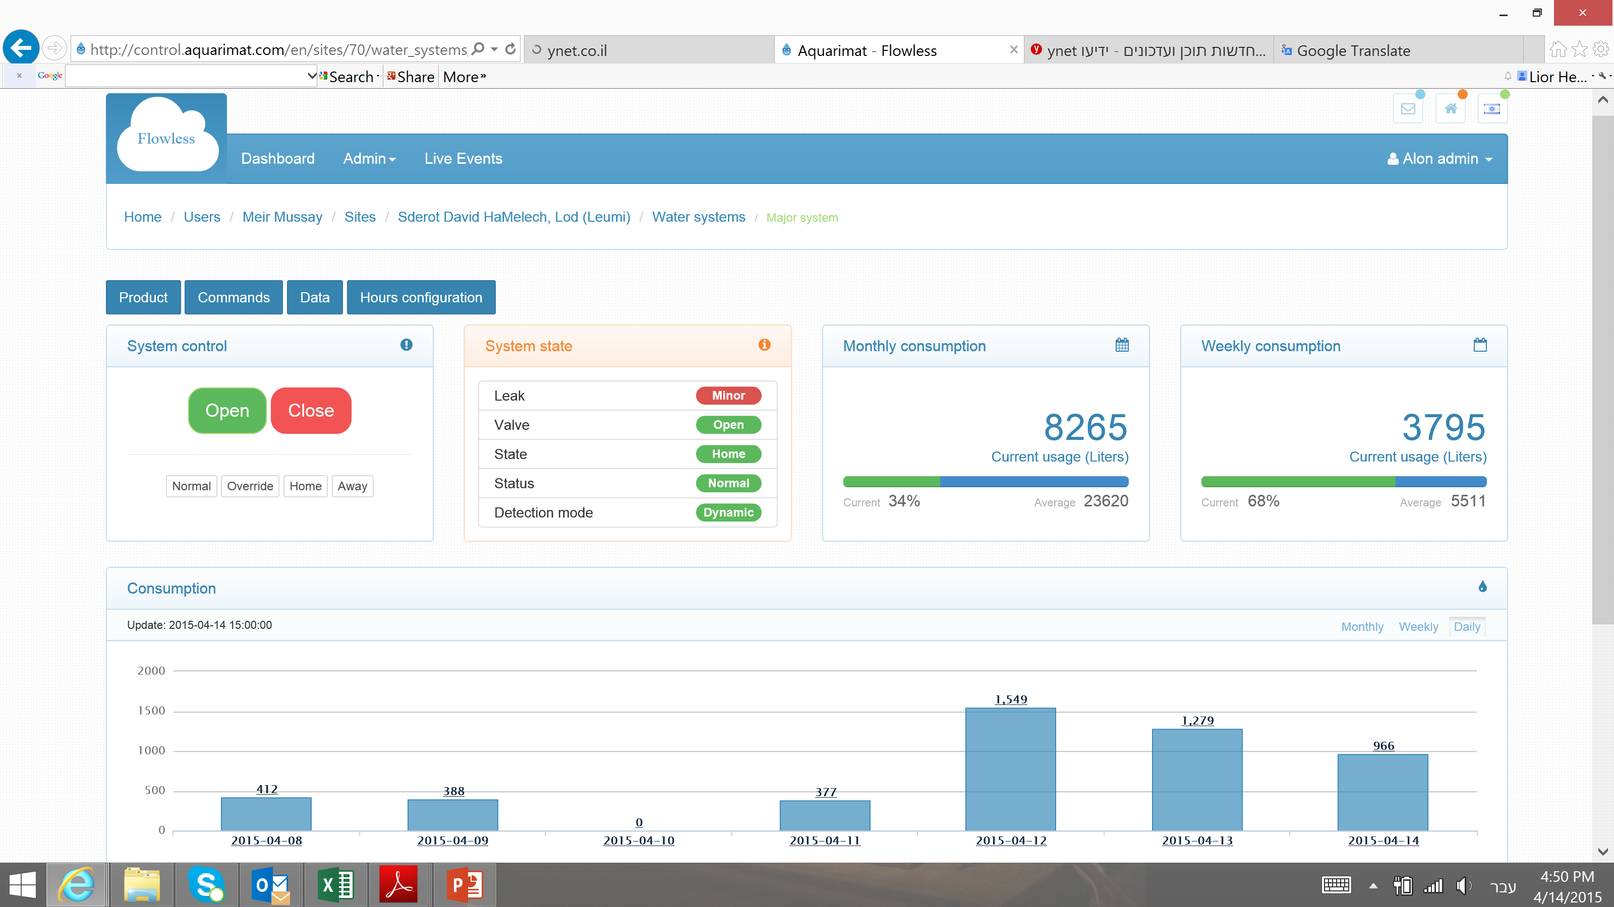
Branch 937 saved during holiday weekend April 11th ,2015
Saturday, Bank closed - showing water consumption
Friday,
Bank closed – No water consumption
3

Slide 4
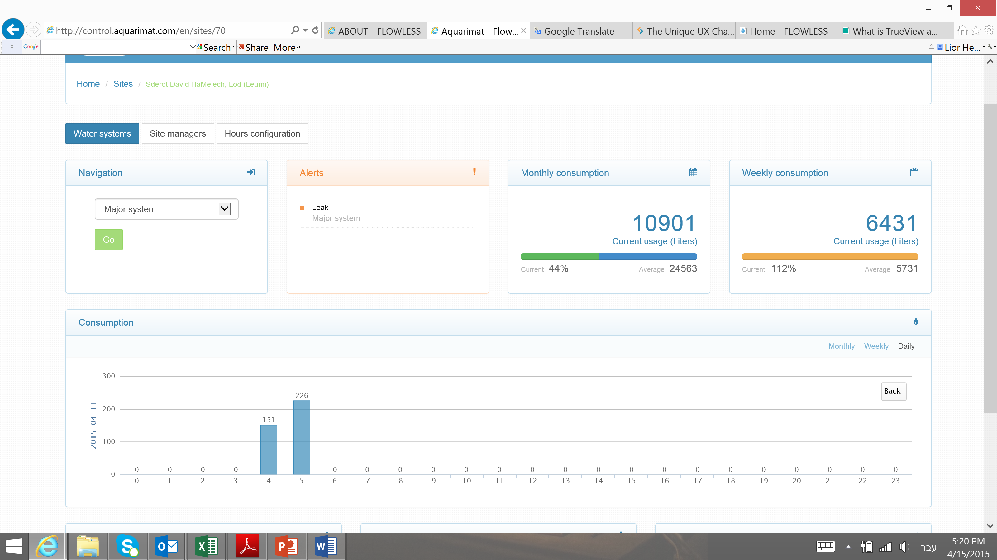
Branch 937– Hourly consumption
Leak started Just before 5am
FlowLess reacts and shuts off valve
Saving the business
4
4

Slide 5
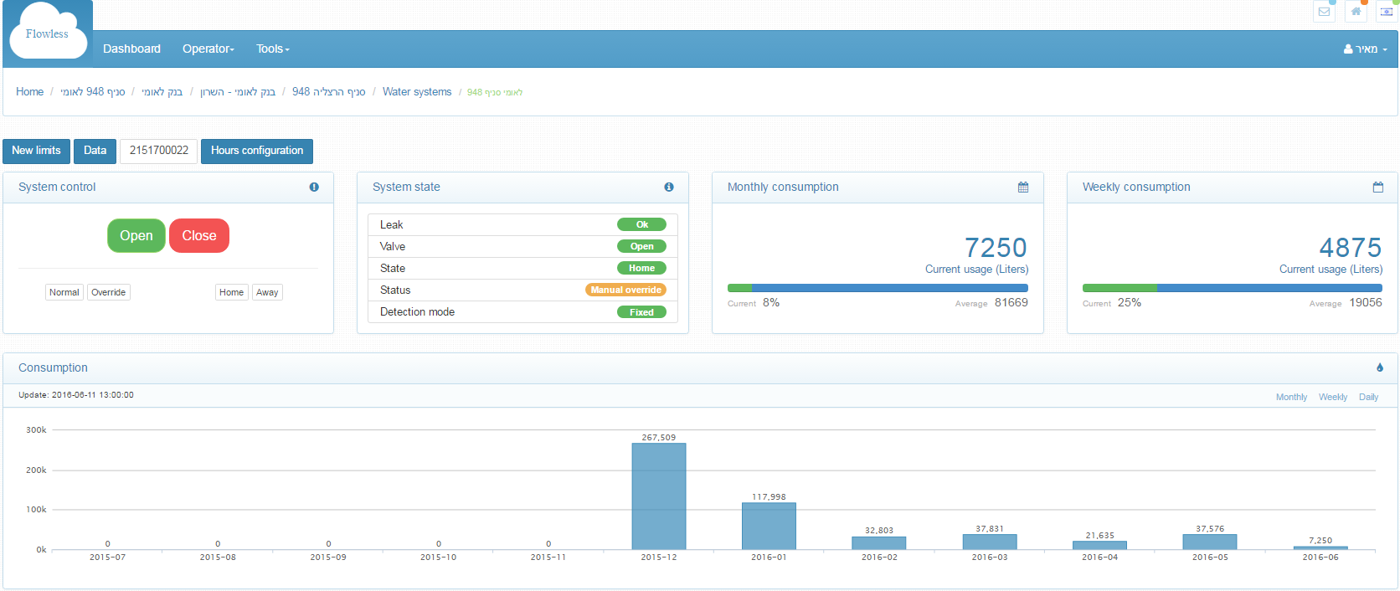
Branch 948 – Persistent water leak
Current monthly consumption ~37,000 litter = 9,700 Gallons
Monthly consumption on Dec 2015 267,509 litter = 70,000 Gallons

Slide 6
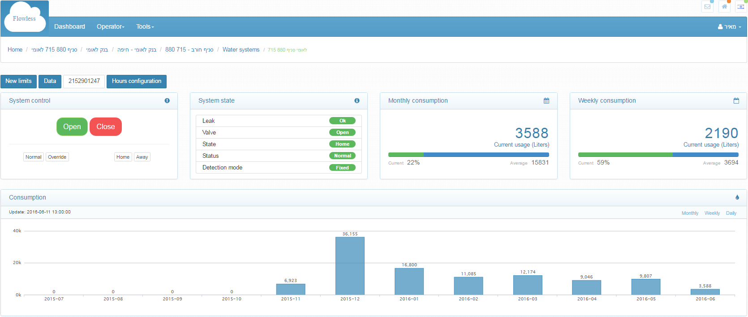
Branch 880 – Persistent water leak
Current monthly consumption ~10,000 litter = 2,600 Gallons
Monthly consumption on Dec 2015 36,115 litter = 9,540 Gallons

Slide 7
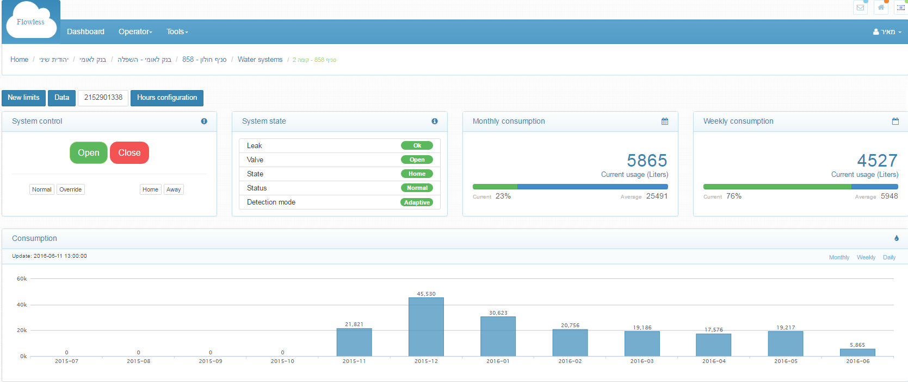
Branch 858 – Persistent water leak
Monthly consumption on Dec 2015 45,530 litter = 12,000 Gallons
Current monthly consumption ~19,000 litter = 5,000 Gallons

Slide 8
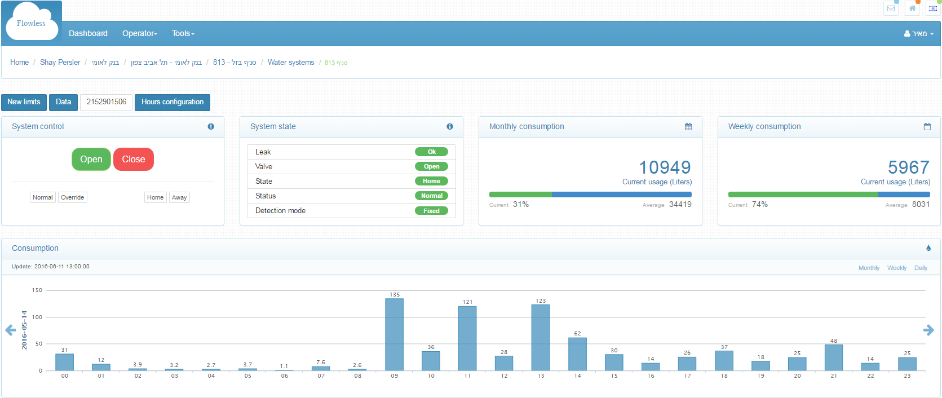
Branch 813 – Unauthorized use of water
Regular domestic consumption during Saturday (branch is closed)

Slide 9
Flowless in Bank Leumi
Annual Savings [$]
22,800 | Water leaks
3,000 | Unauthorized/Unnecessary use
75,000 | Water damage prevention [estimated]
100,800 | Total estimated annual savings
[$]
200,000 | Systems cost
12,000 | Annual fee
Estimated ROI = 2.2 years

